Slide 1
Delivery Performance Analysis Olist-Logistics Dataset
Turning Data into Insights
Jaime Ferretti
Analysis of the delivery process of the Olist-Logistics platform (ETL).
Tools used:
PostgreSQL
Python
https://github.com/ferrettijaime-cmd/Professional_portfolio

Slide 2
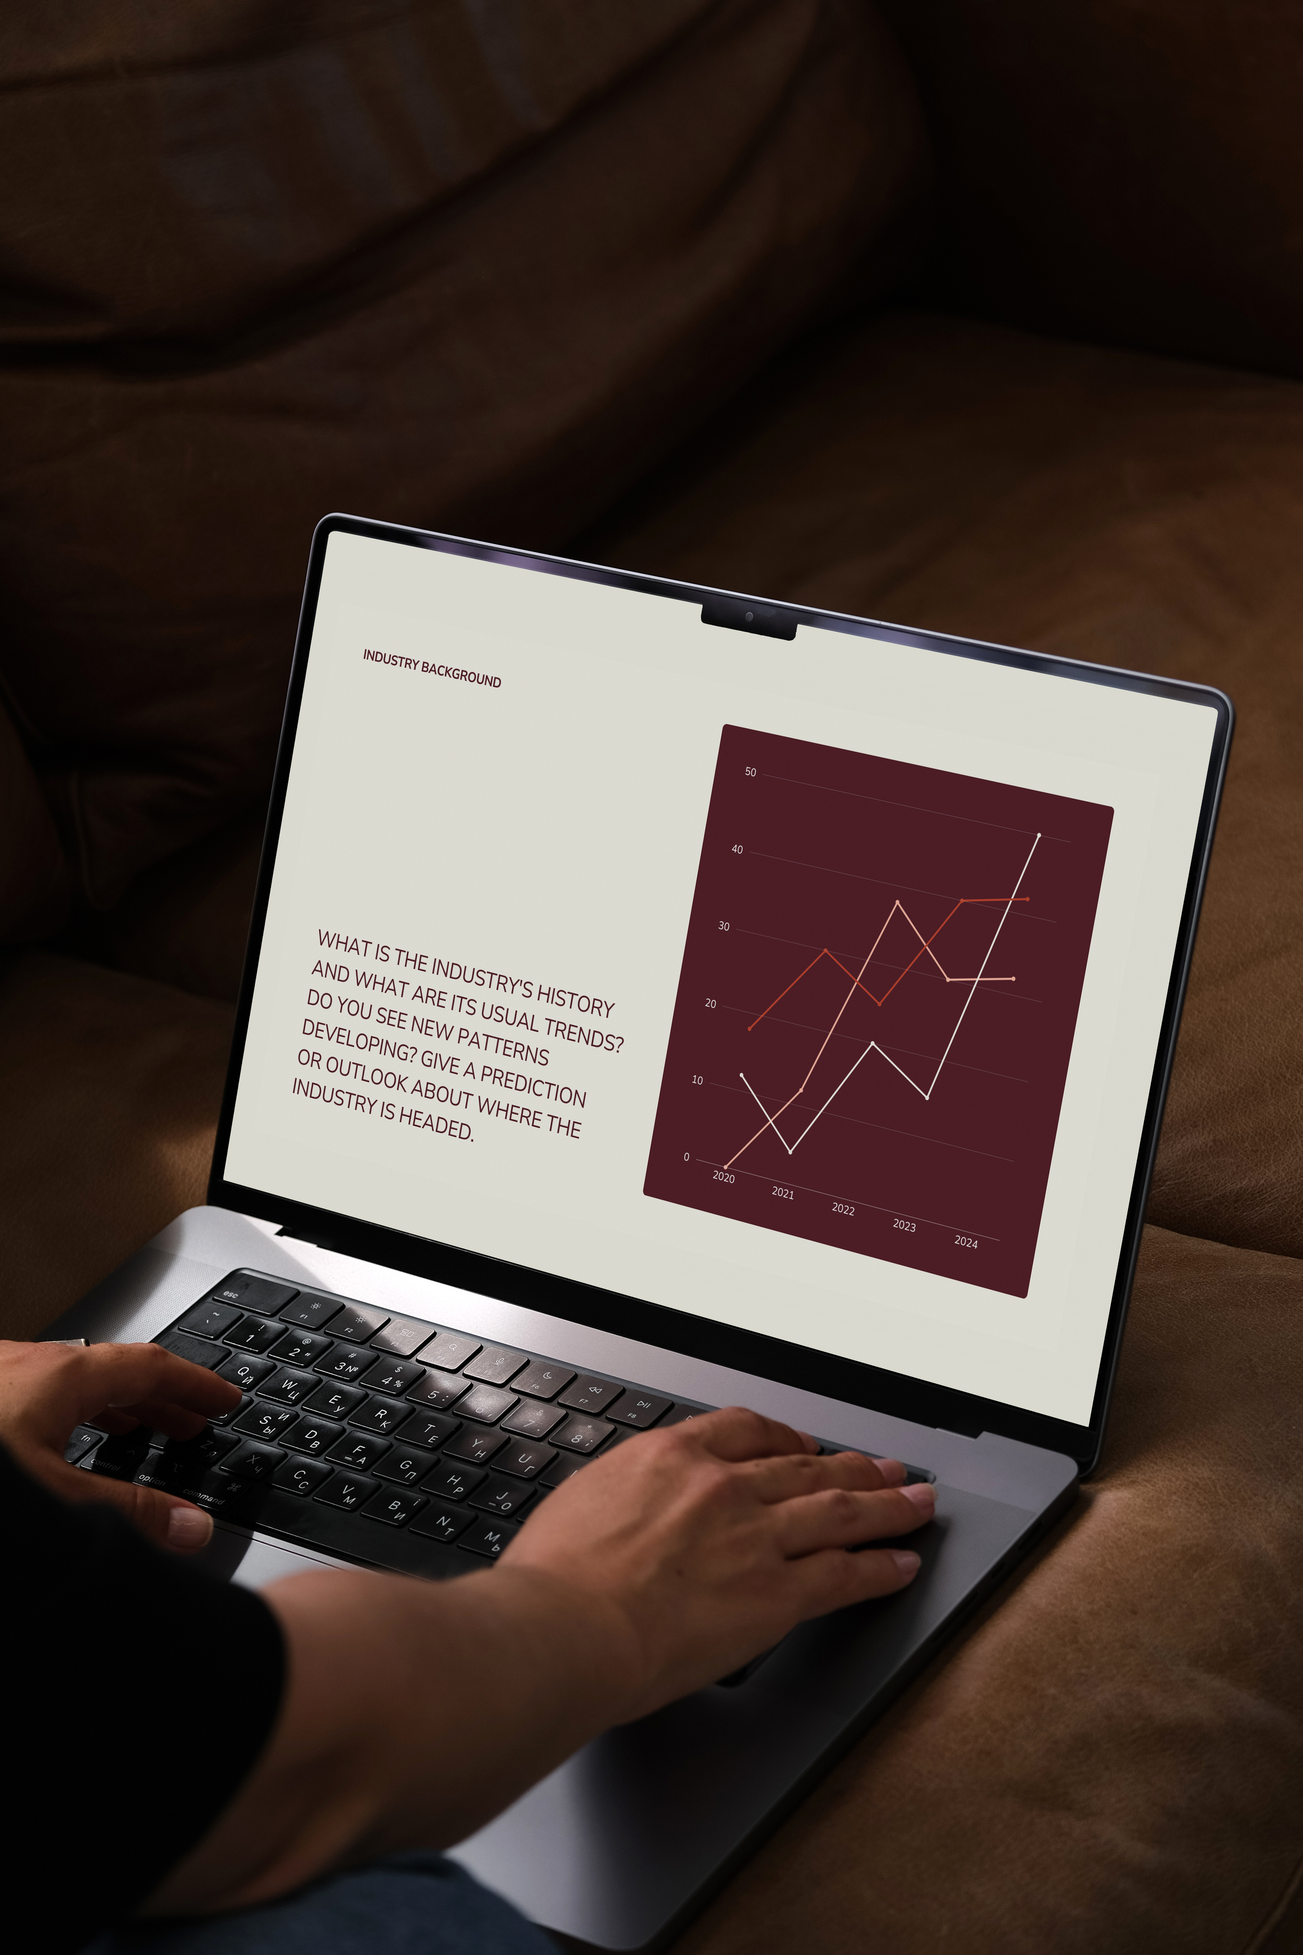
Business Objective
Are delivery deadlines being met?
Answering this question is crucial for the company, as it could lead to new analyses, and most importantly, reveal the company's current position in relation to deliveries.
KPI used:
OTD=(On_time_early_deliveries/Total_deliveriesOn-time​)×100

Slide 3
COLLECT DATA
1
Data Preparation
DATABASE INSERTION
2
3
CREATION OF SCHEMAS
5 Key Steps to Analyze Data
DATA MODELING
4
The steps used for this analysis are briefly described, from the extraction of the CSV file which was saved in the PostgreSQL database; it is a complete process that fulfills the ETL process.
ANALYSIS
5

Slide 4




Tools for
Data Analysis
Essential Software:
For this analysis, I decided to use DBeaver as a client to connect to the Postgre Cloud database. Python plays an important role in data extraction, pipeline construction, and analysis.

Slide 5
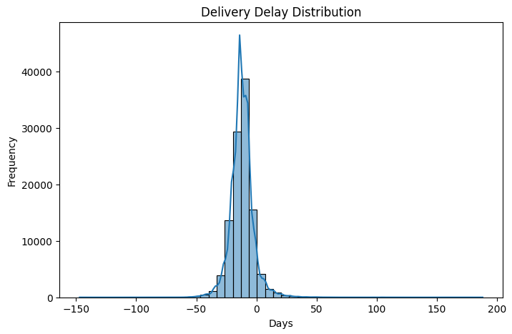
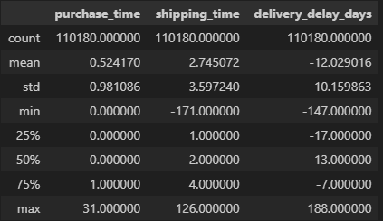
Delivery Delay Distribution
As can be seen in the graph, the data are clearly aligned to the left of the "X" axis, which clearly indicates that the mean value has not been affected by outliers, and this can also be seen by comparing this value with the median, which are very similar.
This reflects that the company has been able to manage deliveries efficiently, resulting in an average early delivery time of 12 days.

Slide 6
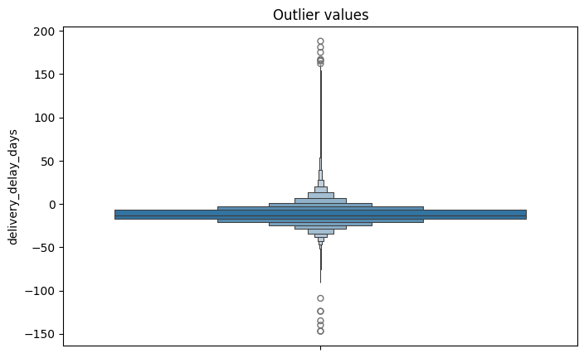
Outlier Management
If we focus on the outliers, we see that, as I indicated before, they did not negatively impact the delivery performance results, and this is also reflected in the graph, where the values ​​are concentrated near zero.

Slide 7
Possible Business Strategy
The consistently early deliveries may suggest the use of conservative estimated delivery dates.
Potential Advantages
Higher customer satisfaction
Positive reviews and trust
Reduced SLA violations
Potential Risks
Customers may perceive delivery times as too long
Lower purchase conversion
Competitive disadvantage

Slide 8

Conclusion of the Analysis
The logistics operation demonstrated excellent delivery performance and a high level of adherence to estimated deadlines. Future analyses could explore customer behavior, regional delivery patterns, or vendor performance to further optimize delivery estimates, as the company's strategy of promising long lead times to achieve its on-time delivery target could lead to new customers switching to competitors, given the shorter estimated delivery time.

Slide 9
Thankyou
Jaime Ferretti
https://github.com/ferrettijaime-cmd/Professional_portfolio

